Slide 1
Talent Development
At HCL

Slide 2
Maven

Slide 3
Agenda
Introduction
Environment Setup
Maven pom.xml
Maven Eclipse Configuration
Dependency

Slide 4
Maven - Introduction
Maven is a project management and comprehension tool that provides developers a complete build lifecycle framework.
Development team can automate the project's build infrastructure in almost no time as Maven uses a standard directory layout and a default build lifecycle.
In case of multiple development teams environment, Maven can set-up the way to work as per standards in a very short time.
As most of the project setups are simple and reusable, Maven makes life of developer easy while creating reports, checks, build and testing automation setups

Slide 5
Maven - Introduction
Maven provides developers way to manage the following –
Build
Documentation
Reporting
Dependencies
Releases
Distribution
To summarize, Maven simplifies and standardizes the project build process. It handles compilation, distribution, documentation, team collaboration and other tasks seamlessly. Maven increases reusability and takes care of most of the build related tasks.

Slide 6
Maven - Introduction
Apache group developed Maven which can build multiple projects together, publish projects information, deploy projects, share JARs across several projects and help in collaboration of teams.
The primary goal of Maven is to provide developer with the following
A comprehensive model for projects, which is reusable, maintainable, and easier to comprehend
Plugins or tools that interact with this model
Maven project structure and contents are declared in an xml file, pom.xml, referred as Project Object Model (POM), which is the fundamental unit of the entire Maven system.

Slide 7
Maven - Convention over Configuration
Maven uses Convention over Configuration, which means developers are not required to create build process themselves.
Developers do not have to mention each and every configuration detail. Maven provides sensible default behavior for projects
When a Maven project is created, Maven creates default project structure. Developer is only required to place files accordingly and he/she need not to define any configuration in pom.xml.
In order to build the project, Maven provides developers with options to mention life-cycle goals and project dependencies (that rely on Maven plugin capabilities and on its default conventions).
Much of the project management and build related tasks are maintained by Maven plugins.
Developers can build any given Maven project without the need to understand how the individual plugins work.

Slide 8
Maven - Introduction
Apache group developed Maven which can build multiple projects together, publish projects information, deploy projects, share JARs across several projects and help in collaboration of teams.
The primary goal of Maven is to provide developer with the following
A comprehensive model for projects, which is reusable, maintainable, and easier to comprehend
Plugins or tools that interact with this model
Maven project structure and contents are declared in an xml file, pom.xml, referred as Project Object Model (POM), which is the fundamental unit of the entire Maven system.

Slide 9
Maven – Environment Setup
Maven is a Java based tool. So JDK (1.7 or above) needs to be installed.
Download Maven Archive - https://maven.apache.org/download.cgi
Extract the Archive - C:\Program Files\Apache Software Foundation\apache-maven-x.x.x
Set Maven Environment variable
M2_HOME=C:\Program Files\Apache Software Foundation\apache-maven-3.3.1 M2=%M2_HOME%\bin MAVEN_OPTS=-Xms256m -Xmx512m
Add Maven bin Directory Location to System Path
Append the string ;%M2% to the end of the system variable, Path

Slide 10
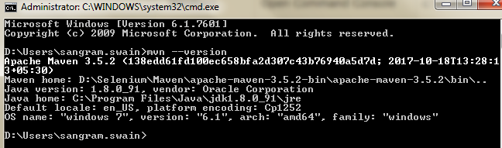
Maven – Environment Setup
Verify installation
Open console and run mvn --version

Slide 11
Maven – POM
POM stands for Project Object Model.
It is fundamental unit of work in Maven. It is an XML file that resides in the base directory of the project as pom.xml.
The POM contains information about the project and various configuration detail used by Maven to build the project(s).
POM also contains the goals and plugins. While executing a task or goal, Maven looks for the POM in the current directory. It reads the POM, gets the needed configuration information, and then executes the goal.
Before creating a POM, we should first decide the project group (groupId), its name (artifactId) and its version as these attributes help in uniquely identifying the project in repository.

Slide 12
Maven – POM
Minimum requirements for a POM -
Node | Description
Project Root | This is project root tag. You need to specify the basic schema settings such as apache schema and w3.org specification
Model Version | Model version should be 4.0.0.
groupId | This is an Id of project's group. This is generally unique amongst an organization or a project. For example, a banking group com.company.bank has all bank related projects.
artifactId | This is an Id of the project. This is generally name of the project. For example, consumer-banking. Along with the groupId, the artifactId defines the artifact's location within the repository.
version | This is the version of the project. Along with the groupId, It is used within an artifact's repository to separate versions from each other.

Slide 13
Maven – Build Cycle
Phase | Handles | Description
prepare-resources | resource copying | Resource copying can be customized in this phase.
validate | Validating the information | Validates if the project is correct and if all necessary information is available.
Compile | Compilation | Source code compilation is done in this phase.
Test | Testing | Tests the compiled source code suitable for testing framework.
Package | Packaging | This phase creates the JAR/WAR package as mentioned in the packaging in POM.xml.
Install | Installation | This phase installs the package in local/remote maven repository.
Deploy | Deploying | Copies the final package to the remote repository.

Slide 14
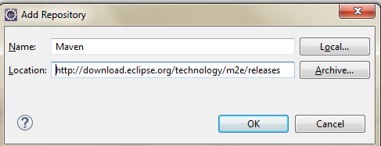
Maven – Eclipse Plugin
Eclipse -> Help -> Install New Software
Mention the name as Maven and Location as - Maven - http://download.eclipse.org/technology/m2e/releases
Maven plugin will be downloaded and installed.

Slide 15
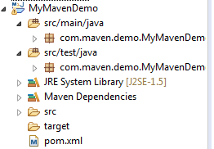
Maven – Eclipse Project Creation
Eclipse -> File -> New -> Others -> Select “Maven Project”
Select on next (let it select the default options automatically)
Group Id is the package name.
Artifact Id is the project name.
It will create a project.
Source Code
Test Code
All Dependency
POM file

Slide 16
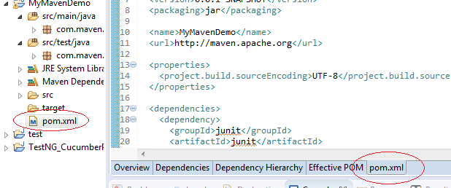
Maven – Eclipse Project Creation
Click on the pom.xml file. (Training_Maven_TestNG)
You can edit this file for adding any dependency.

Slide 17
Maven – Adding Dependency
Let’s see how to add Selenium dependency.
Google “maven selenium dependency”.
Select any of the retrieved result.
Copy the result and paste it in the pom.xml file between the tags <dependencies> and </dependencies>
<dependency>
<groupId>org.seleniumhq.selenium</groupId>
<artifactId>selenium-java</artifactId>
<version>2.53.1</version>
</dependency>
Once you save the xml file, the corresponding jar files of Selenium will be downloaded and included under Maven Dependencies folder.

Slide 18
Maven – Adding Dependency
Let’s see how to add TestNG dependency.
Google “maven TestNG dependency”.
Select any of the retrieved result.
Copy the result and paste it in the pom.xml file between the tags <dependencies> and </dependencies>
<dependency>
<groupId>org.testng</groupId>
<artifactId>testng</artifactId>
<version>6.8</version>
<scope>test</scope>
</dependency>
Once you save the xml file, the corresponding jar files of TestNG will be downloaded and included under Maven Dependencies folder.

